Slide 1
Relationship Between Variables
More EDA

Slide 2
Correlation Test
When performing EDA, we would like to examine the relationship between variables.
We can usually infer relationships between variables by looking at various visualizations (like scatter plots).
We can also examine the type and strength of a relationship using basic statistics. Lets take a look at some approaches today

Slide 3
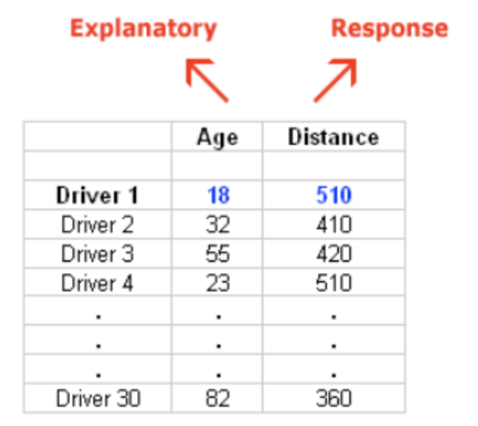
Part 1 - Correlation between quantitative variables
Data Description: A Pennsylvania research firm conducted a study in which 30 drivers (of ages 18 to 82 years old) were sampled, and for each one, the maximum distance (in feet) at which he/she could read a newly designed sign was determined. The goal of this study was to explore the relationship between a driver’s age and the maximum distance at which signs were legible, and then use the study’s findings to improve safety for older drivers. (Reference: Utts and Heckard, Mind on Statistics (2002). Originally source: Data collected by Last Resource, Inc, Bellfonte, PA.)
Here is what the raw data looks like:
the explanatory (X) variable is Age, and
the response (Y) variable is Distance

Slide 4
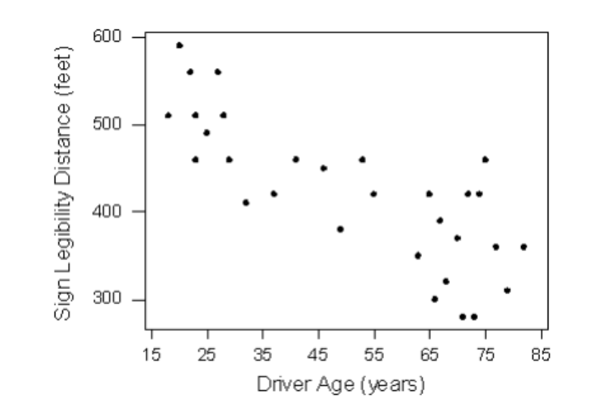
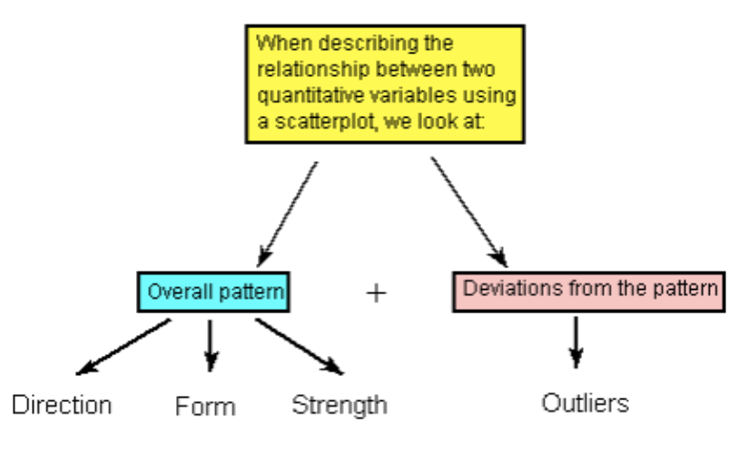
Part 1 - Correlation between quantitative variables (Cont.)
Scatter plot of the data
How should we interpret the scatter plot?
When describing the overall pattern of the relationship we look at its direction, form and strength.

Slide 5
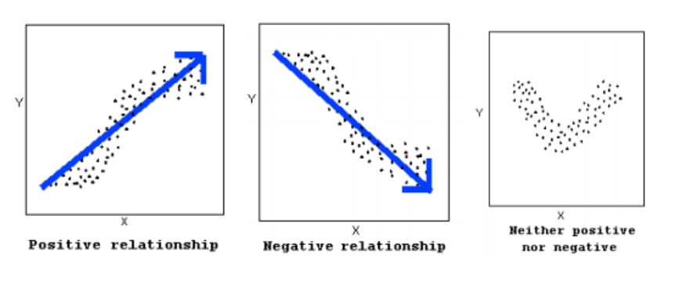
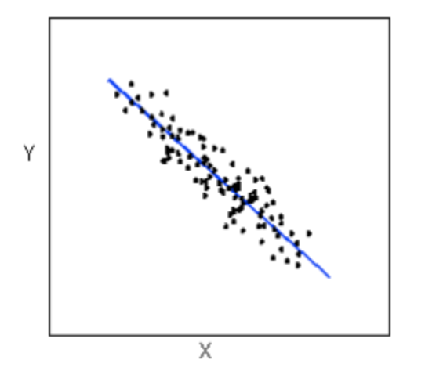
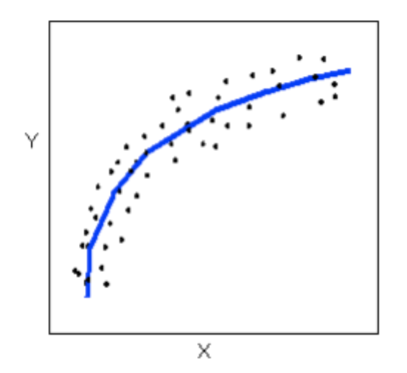
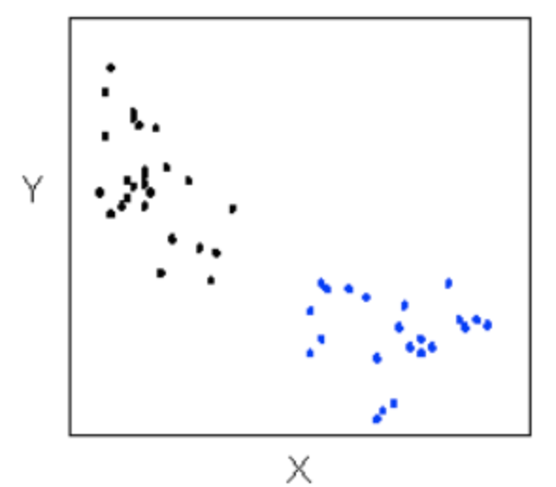
Part 1 - Correlation between quantitative variables (Cont.)
The direction of the relationship can be positive, negative, or neither:
A positive (or increasing) relationship means that an increase in one of the variables is associated with an increase in the other.
A negative (or decreasing) relationship means that an increase in one of the variables is associated with a decrease in the other.
Not all relationships can be classified as either positive or negative.
The form of the relationship is its general shape. When
identifying the form, we try to find the simplest way to describe
the shape of the scatterplot.

Slide 6
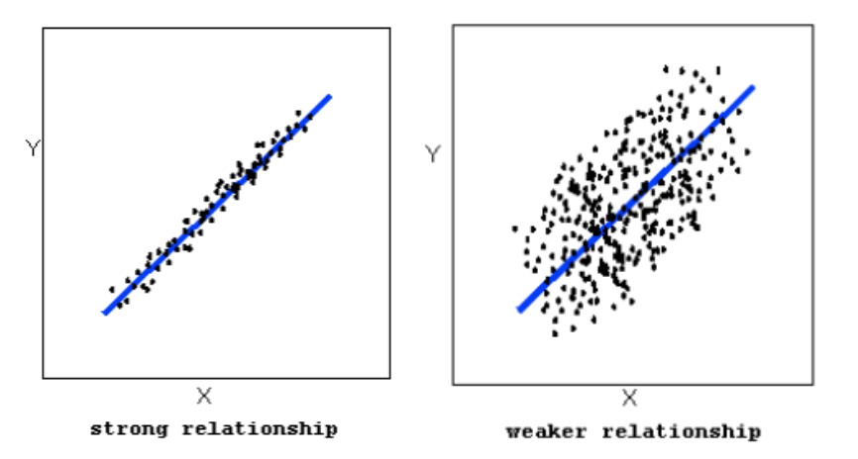
Part 1 - Correlation between quantitative variables (Cont.)
The strength of the relationship is determined by how closely the data follow the form of the relationship. Let’s look, for example, at the following two scatterplots displaying positive, linear relationships:

Slide 7
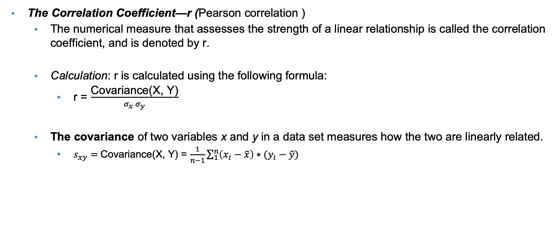
Part 1 - Correlation between quantitative variables (Cont.)

Slide 8
Part 1 - Correlation between quantitative variables (Cont.)
The Correlation Coefficient—r (Pearson correlation )
The numerical measure that assesses the strength of a linear relationship is called the correlation coefficient, and is denoted by r.
Calculation: r is calculated using the following formula:
r = covariance(X, Y) / (stdv(X) * stdv(Y))
Interpretation and Properties: Once we obtain the value of r, its interpretation with respect to the strength of linear relationships is quite simple, as this walkthrough will illustrate:
The value of r ranges from -1 to 1
Negative values of r indicate a negative direction for a linear relationship
Positive value of r indicate a positive direction for a linear relationship
Values of r close to zero indicate a weak linear relationship.
Values of r close to 1/-1 indicate a strong linear relationship

Slide 9
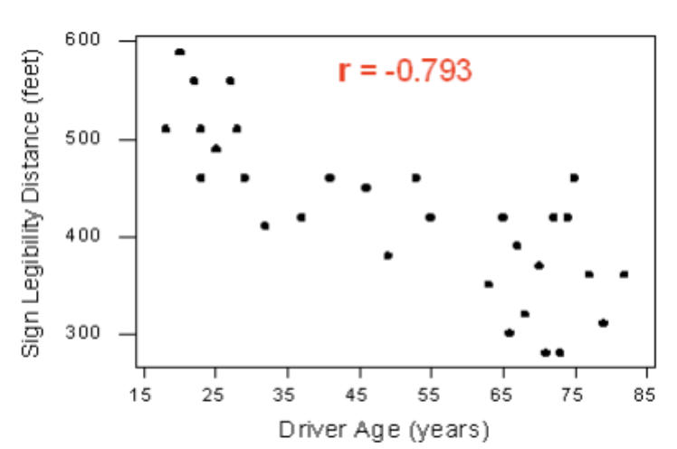
Part 1 - Correlation between quantitative variables (Cont.)
Example : Earlier, we used the scatterplot below to find a negative linear relationship between the age of a driver and the maximum distance at which a highway sign was legible.
What about the strength of the relationship?
It turns out that the correlation between the two variables is r = -0.793.

Slide 10
Part 2 - Correlation between categorical variables
We can observe the relationship between two categorical variables using graphs.
We will perform statistical inference for two categorical variables, using the sample data to draw conclusions about whether or not we have evidence that the variables are related in the larger population from which the sample was drawn.
In other words, we would like to assess whether the relationship between X and Y that we observed in the data is due to a real relationship between X and Y in the population, or if it is something that could have happened just by chance due to sampling variability.
We always assume that the data we have is a sample as we are unable to collect all instances / observations

Slide 11
Part 2 - Correlation between categorical variables
The statistical test that will answer this question is called the chi-square test of independence.
Chi is a Greek letter that looks like this: χ, so the test is sometimes referred to as: The χ2 test of independence.

Slide 12
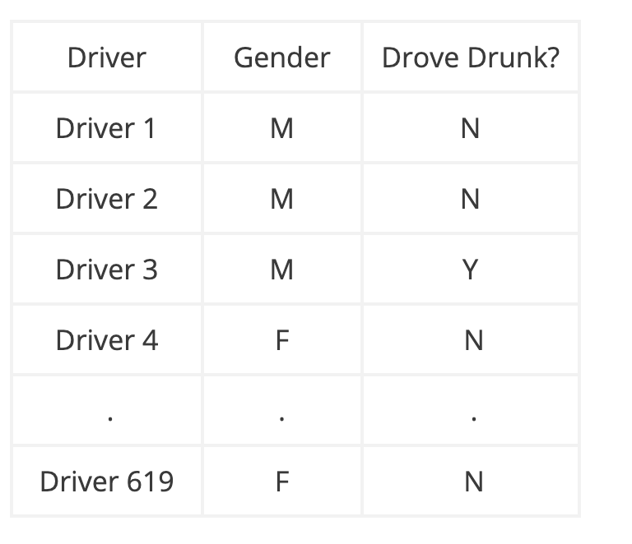
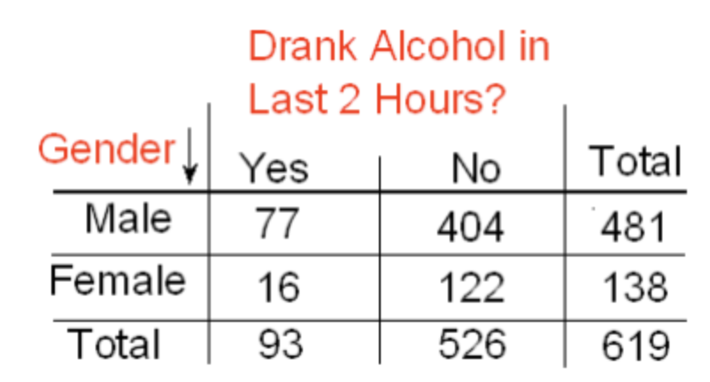
Part 2 - Correlation between categorical variables
Example: In the early 1970s, a young man challenged an Oklahoma state law that prohibited the sale of 3.2% beer to males under age 21 but allowed its sale to females in the same age group. The case (Craig v. Boren, 429 U.S. 190 [1976]) was ultimately heard by the U.S. Supreme Court. The main justification provided by Oklahoma for the law was traffic safety. One of the 3 main pieces of data presented to the Court was the result of a “random roadside survey” that recorded information on gender and whether or not the driver had been drinking alcohol in the previous two hours. There were a total of 619 drivers under 20 years of age included in the survey. Here is what the collected data looked like:
Note that we are looking to see whether drunk driving is related to gender, so the explanatory variable (X) is gender, and the response variable (Y) is drunk driving.

Slide 13
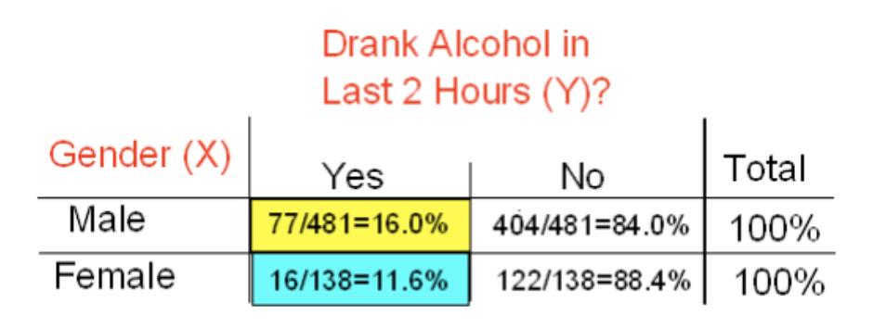
Part 2 - Correlation between categorical variables
Let us do basic EDA and look at percentages of
drunk driving between genders:
For the 619 sampled drivers, a larger percentage of males were found to be drunk than females, hence, the data provides some evidence that drunk driving is related to gender.
However, this in itself is not enough to conclude that such a relationship exists in the larger population of drivers under 20.
We need to further investigate the data and decide between the following two points of view:
The evidence provided by the roadside survey (16% vs. 11.6%) is strong enough to conclude (beyond a reasonable doubt) that it must be due to a relationship between drunk driving and gender in the population of drivers under 20.
The evidence provided by the roadside survey (16% vs. 11.6%) is not strong enough to make that conclusion and could just have happened by chance due to sampling variability, and not necessarily because a relationship exists in the population.

Slide 14
Part 2 - Correlation between categorical variables
The Chi-Square Test of Independence
The chi-square test of independence examines our observed data and tells us whether we have enough evidence to conclude beyond a reasonable doubt that two categorical variables are related.
Step 1: Stating the Hypothesis
Ho: (They are independent.) There is no relationship between gender and drunk driving.
Ha: (They are not independent.) There is a relationship between gender and drunk driving.
Step 2: Measure how far the data are from what is claimed in the null hypothesis.
For the null hypothesis, we need to calculate the counts that we would expect to see if drunk driving and gender were really independent (i.e., if Ho were true).
For example, we actually observed 77 males who drove drunk; if drunk driving and gender were indeed independent (if Ho were true), how many male drunk drivers would we expect to see instead of 77?
So, we need to calculate:
The observed counts (the data)
The expected counts (if Ho were true)

Slide 15
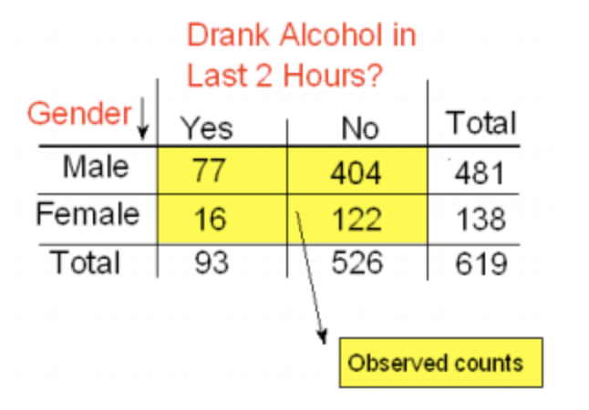
Part 2 - Correlation between categorical variables
The Chi-Square Test of Independence ( Example continued)
So, we need to estimate the size of the discrepancy between what we observed and what we would expect to observe if Ho were true.
P(Drunk) = 93 / 619 and
P(Male) = 481 / 619, and so,
P(Drunk and Male) = P(Drunk) * P(Male) = (93 / 619) (481 / 619)
Therefore, since there are total of 619 drivers, if drunk driving and gender were independent, the count of drunk male drivers that I would expect to see is:
Expected Count = 619∗P(Drunk and Male)=619*(93/619)*(481/619)=(93∗481)/619

Slide 16
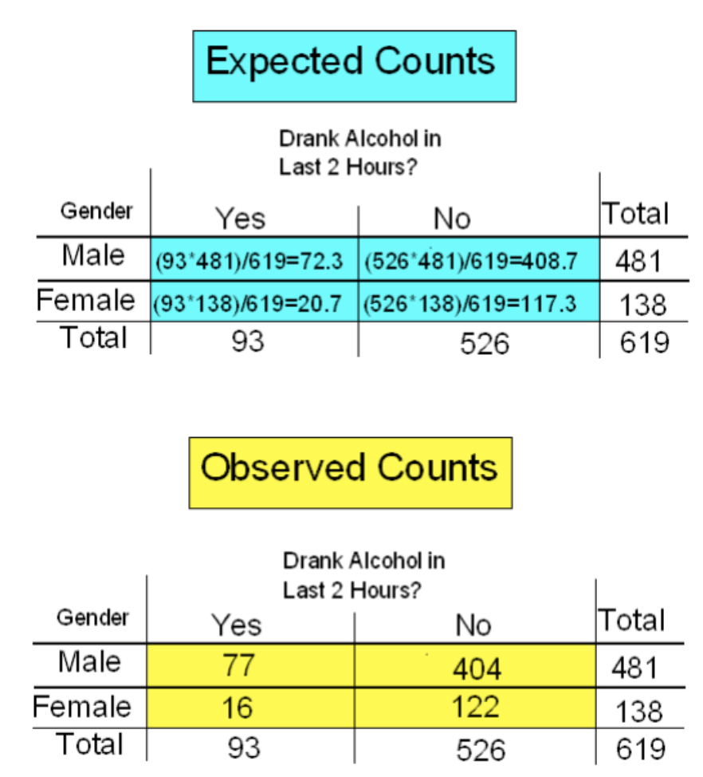
Again, the expected count equals the product of the corresponding column and row totals, divided by the overall table total. This will always be the case and will help streamline our calculations:
Expected Count = (Column Total x Row Total)/(Table Total)

Slide 17
Part 2 - Correlation between categorical variables
Step 3: Finding the P-Value
The p-value for the chi-square test for independence is the probability of getting counts like those observed, assuming that the two variables are not related (which is claimed by the null hypothesis).
The smaller the p-value, the more surprising it would be to get counts like we did if the null hypothesis were true.
Step 4: Stating the Conclusion in Context
A small p-value indicates that the evidence provided by the data is strong enough to reject Ho and conclude (beyond a reasonable doubt) that the two variables are related.
In particular, if a significance level of .05 is used, we will reject Ho if the p-value is less than .05

